Slide 1
Semicondutores, microeletrônica: desenvolvimento de tecnologia e qualificação de mão de obra
Caso TSMC – algumas lições
Prof. Gilberto Medeiros Ribeiro
Departamento de Ciência da Computação
UFMG

Slide 2
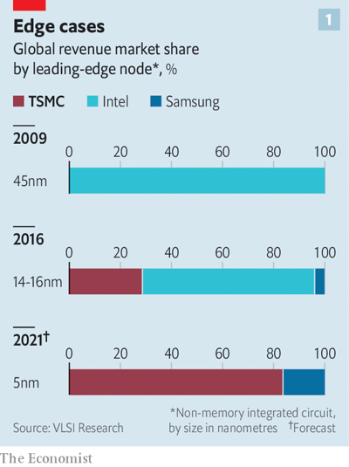
TSMC
Investimentos em fábricas:
“In April TSMC raised the figure again, to $30bn; 80% will go on advanced technologies. It plans to spend $100bn over the next three years.”

Slide 3
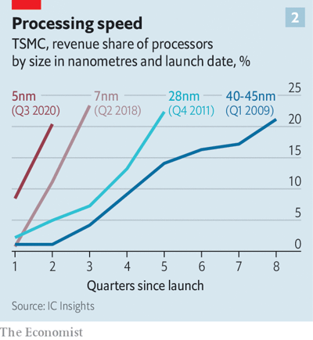
TSMC
“Four technological generations ago it took TSMC two years for those cutting-edge chips to make up 20% of revenues; the latest generation needed just six months to reach the same level”

Slide 4
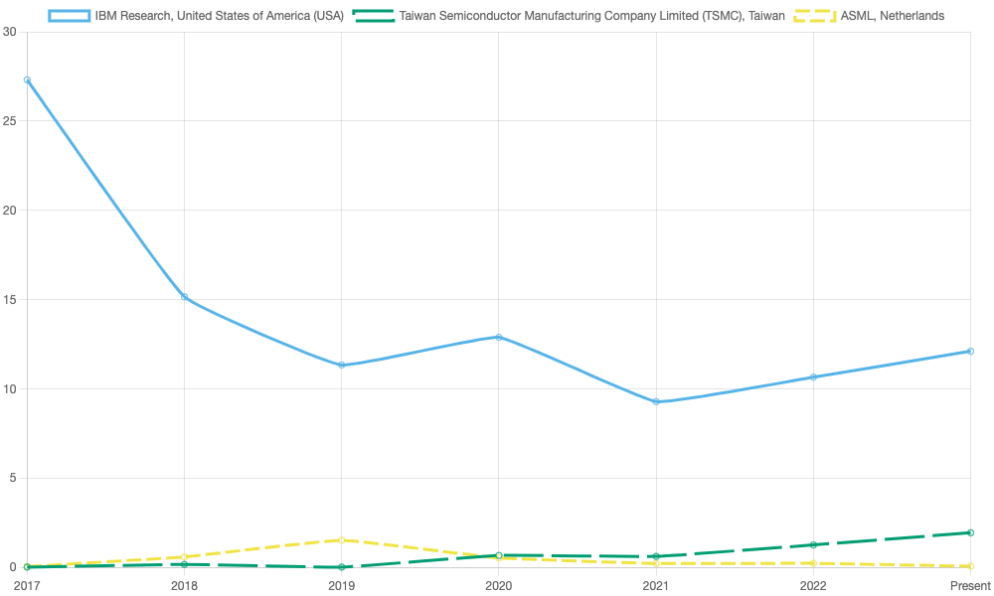
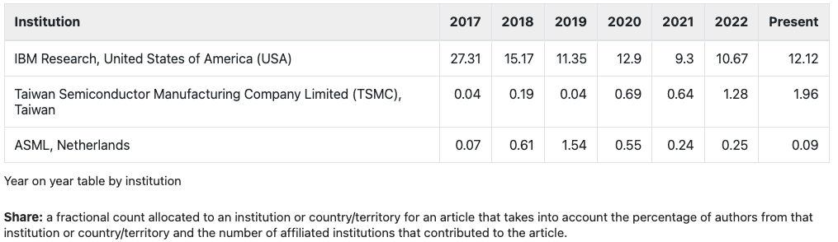

Slide 5
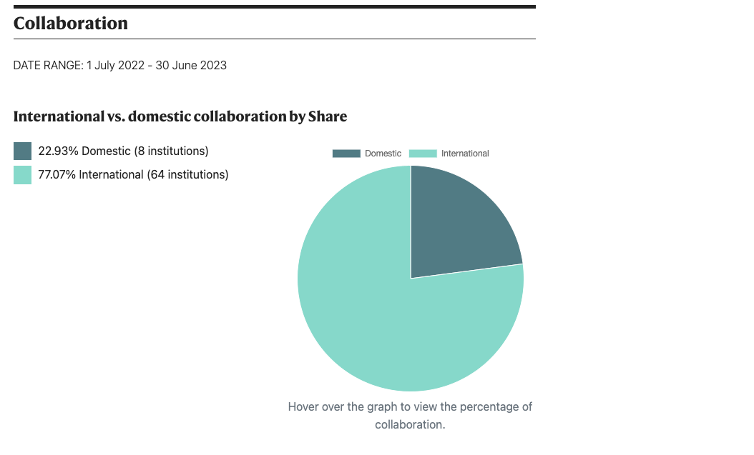

Slide 6
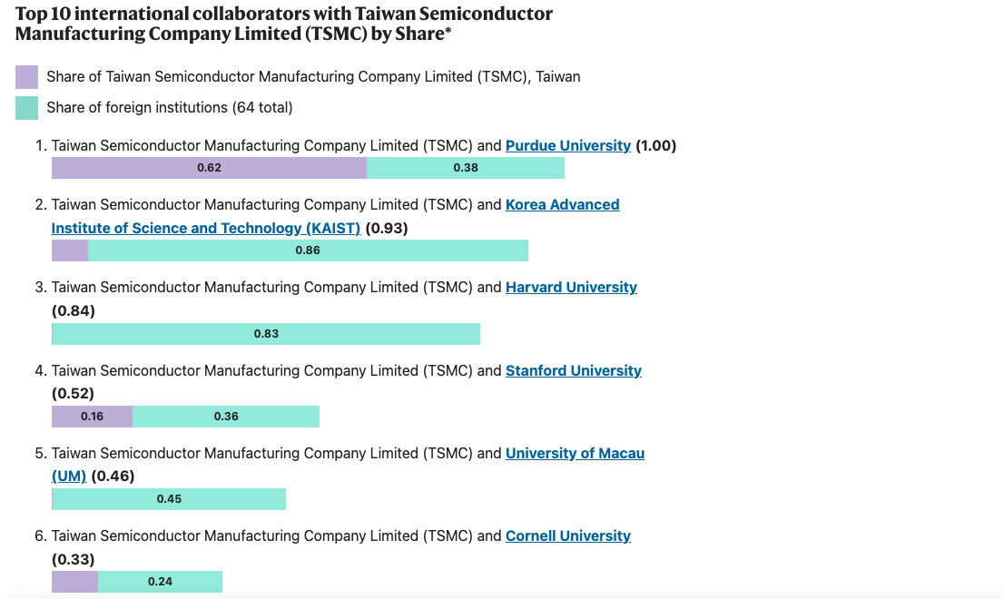
*Share is the fractional count allocated to an institution for an article that takes into account the percentage of authors from that institution and the number of affiliated institutions that contributed to the article. The horizontal stacked bar charts above indicate the Share contributed by each institution in the bilateral collaboration.

Slide 7
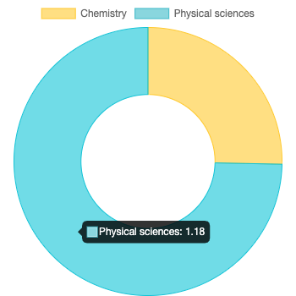
Research outputs for Taiwan Semiconductor Manufacturing Company Limited (TSMC) published between 1 July 2022 - 30 June 2023 which are tracked by the Nature Index.

Slide 8
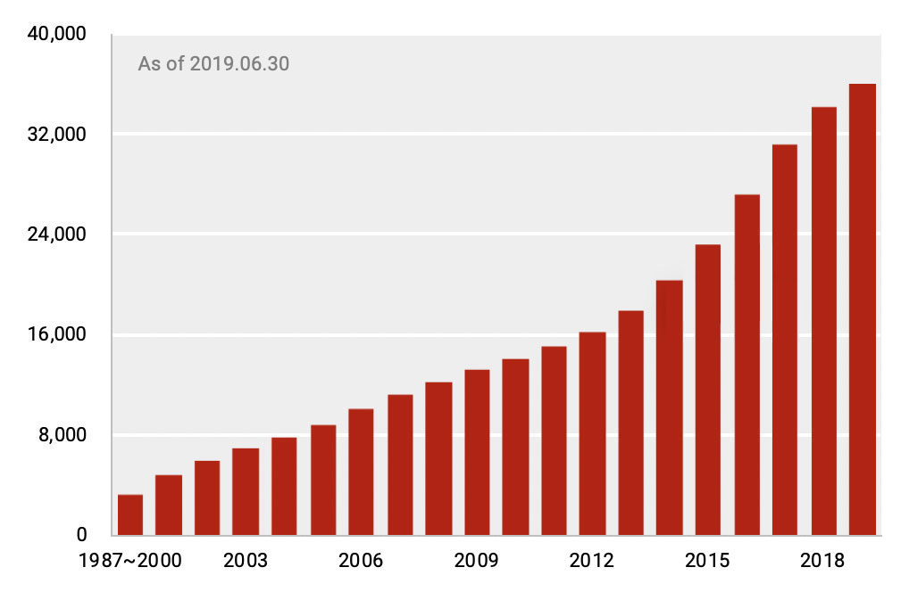
TSMC's Patent Grants Worldwide

Slide 11
Conclusões/pontos para reflexão
Pesquisa básica + proteção de PI = Inovação;
16 anos para início de exportação; 30 anos até presença ubíqua;
Contínuo apoio do governo
Parcerias e internacionalização
“Invisible but essential”
Wired magazine, May 2023

